Slide 1




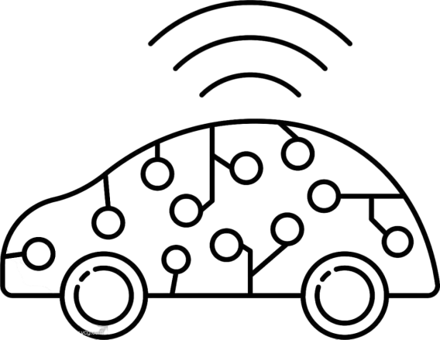


Summer 2023 Year 2 Short Semester Design & Build Project
"TreasureCorsair"--Intelligent
Robot Treasure Hunting System
Member：
黄保鑫 左偲彤 范一鸣 张宇琛 常睿轩
韩宗桓 王嘉烁 王栎凯 李暠
Time：2023/10/11

Slide 2





Contents
目录
Telecom
IoT
E-Commerce
Gantt chart
Time line
Apperance
Hardware
Logic
Team
Profile
Planning
&
Scheduling
Design
Ideas
Function
Show
Summary
&
Experience

Slide 3





Team Profile （Telecom）
Ruixuan Chang 常睿轩
团队介绍
In the telecom team, primarily responsible for visual promotion, including: Providing guidance on the design of the robotic car's appearance and functionality. Creating explanatory documents and PowerPoint presentations.
Yiming Fan 范一鸣
In the team, primarily responsible for overall design and leadership, including: project planning, scheduling, organizing and conducting meetings, overall project coordination and integration, and creating PowerPoint presentations.
In the telecom team, mainly responsible for the algorithmic logic part, including: writing code for the ultrasonic distance measurement section,writing logic code for the maze exploration of the robotic car,coding for maze mapping,creating logic for treasure detection by the robotic car.Writing code for controlling different modes of the car. Code integration and testing, testing and parameter tuning for new features and modules.
Baoxing Huang 黄保鑫
In the telecom team, primarily responsible for algorithmic logic design, including: Writing code for the robotic car's infrared remote control module. Developing code for the color recognition module. Handling circuit connections and related tasks.
Sitong Zuo 左偲彤
In the team, primarily responsible for financial management, including: purchasing new components for our outings and managing finances.
In the telecom team, primarily responsible for comprehensive debugging and hardware design, including: Assembling the robotic car and connecting motor drivers. Installing various module components. Writing code for the Bluetooth data transmission module and merging module code. Designing the appearance of the robotic car. Testing and parameter tuning for new features and modules. Troubleshooting, detecting, and repairing equipment faults. Organizing and planning time schedules for overall coordination. Handling financial operations, among other tasks.
Yuchen Zhang 张宇琛
In the telecom team, primarily responsible for hardware logic design, including: Initial assembly of the robotic car. Partial wiring and connections. Writing code for capturing photos via WiFi and controlling the gimbal to adjust the camera angle. Programming the buzzer to sound at specific intervals. Using vibration sensors to detect collisions. Testing and writing code for temperature and humidity sensors. Physically connecting and integrating the temperature and humidity sensors. Displaying temperature and humidity data on an LCD screen. Writing code to record temperature and humidity data over time. Managing the procurement of damaged components. Handling financial management responsibilities.

Slide 4
Team Profile （E-Commerce & IOT）
团队介绍
Jiashuo Wang 王嘉烁
Mainly responsible for the page design section, including the design and artwork of the basic webpage components, as well as implementing error-tolerant functionalities for individual user login, registration, and handling account/password errors or duplicate registrations.
Wangzi Li 李王子
Zonghuan Han 韩宗桓
Mainly responsible for code Writing and Cleaning, organizing, and preparing data for analysis; feeding data to the model, optimizing parameters, and monitoring performance, training models
Mainly responsible for the page design section, including interfacing with the database, displaying the basic data and exploration records of the robot, and implementing the editing functionality for robot basic data.
Shuokai Wang 王栎凯
Mainly responsible for code writing feeding data to the model, optimizing parameters, and monitoring performance, and GUI (Graphical User Interface) design.

Slide 5
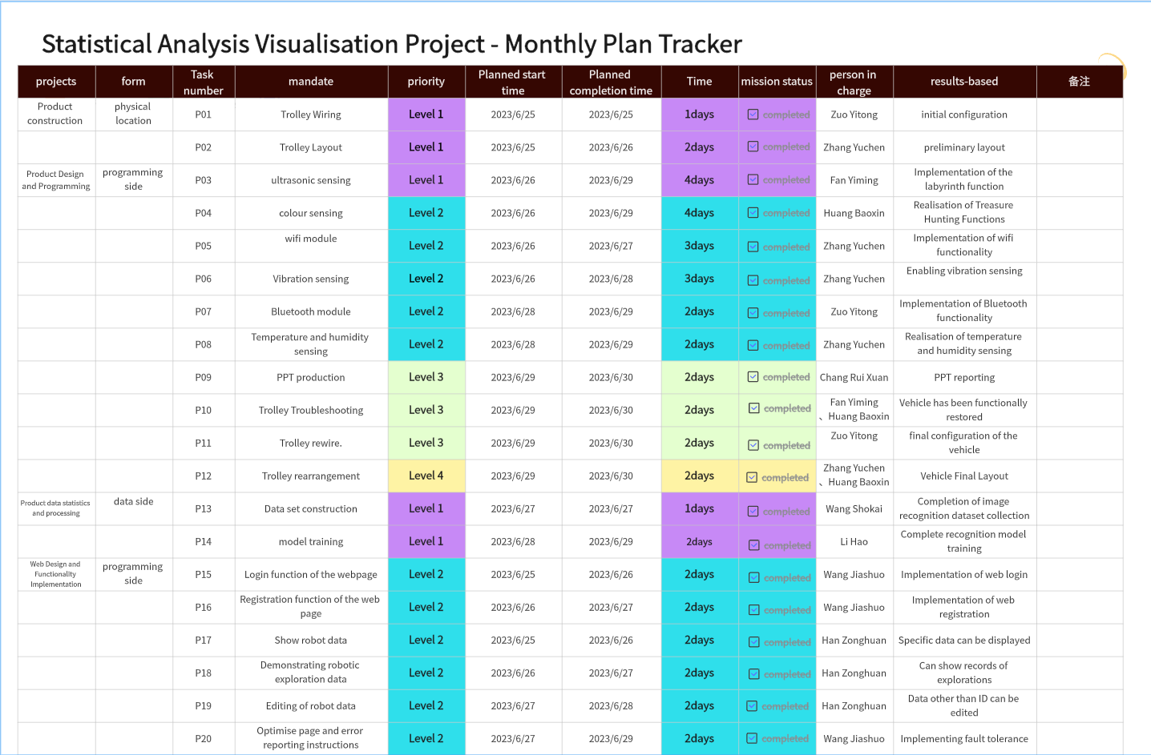
Planning & Scheduling
计划与时间安排

Slide 6
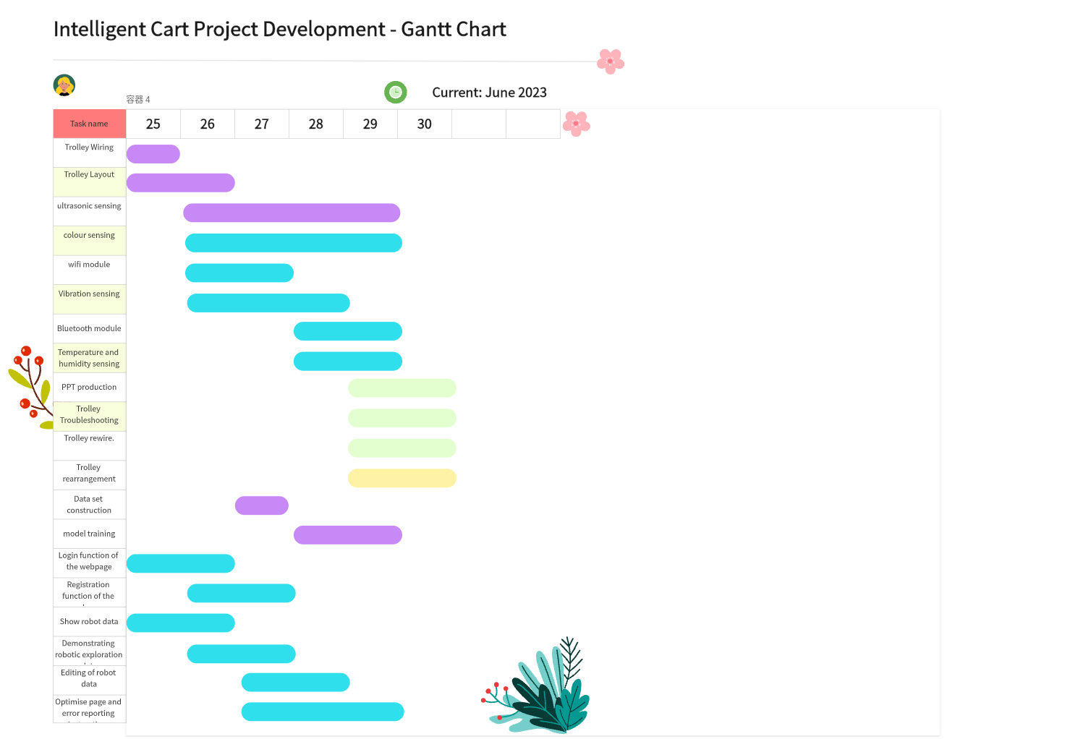
Planning & Scheduling
计划与时间安排

Slide 7





Design Ideas（Overall Introduction）
设计思路
"TreasureCorsair"
Smart Car
User manuals
Treasure identification system
Information Transfer Software
Advocacy and data storage website

Slide 8
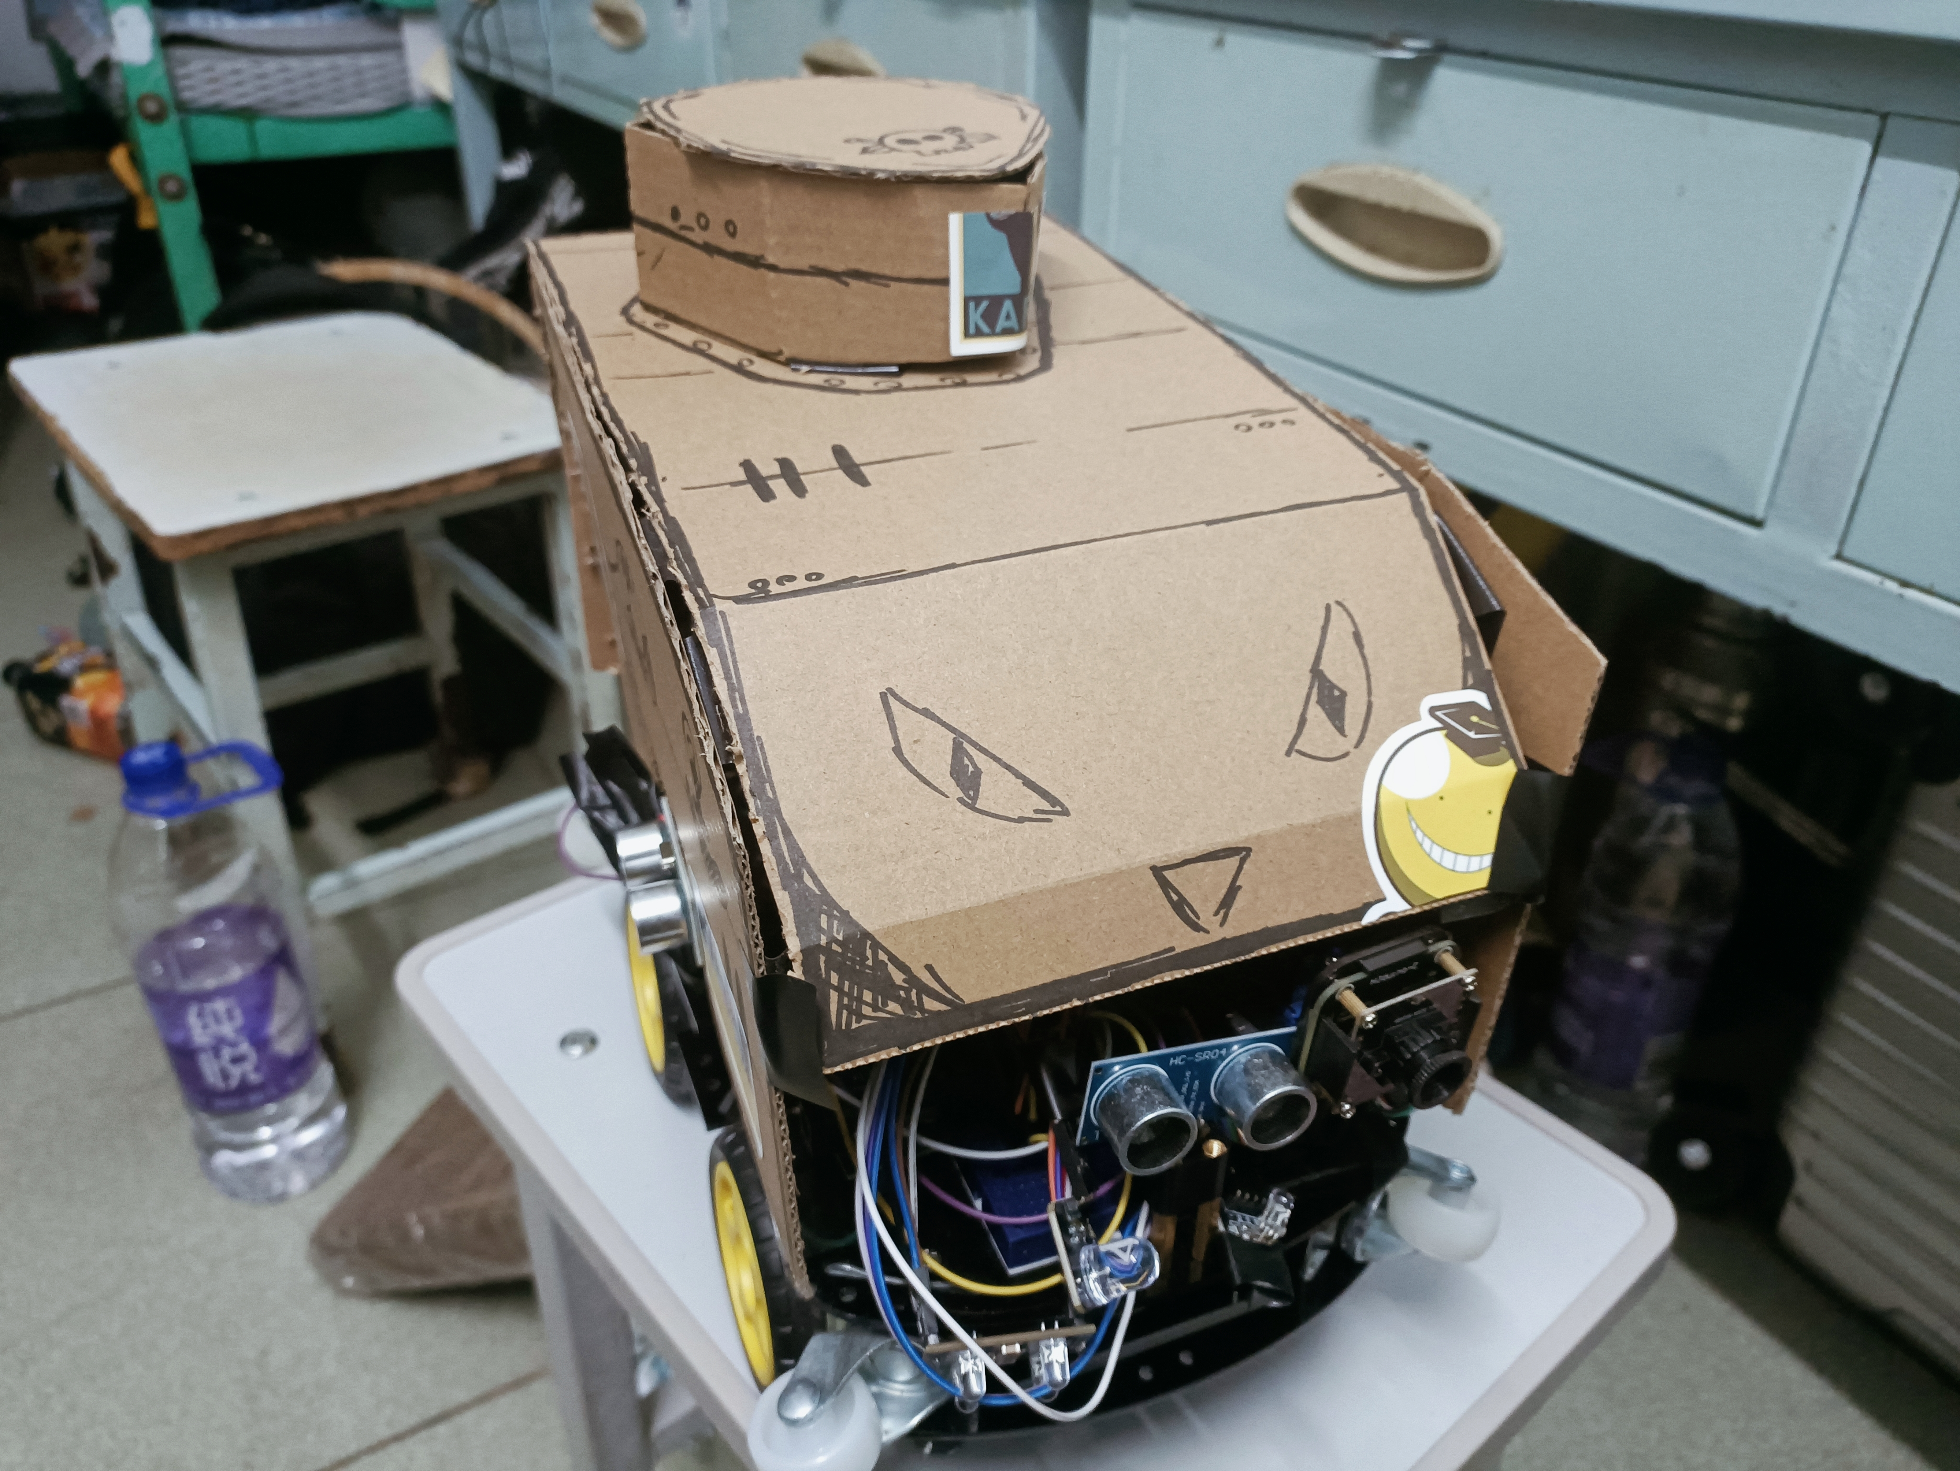
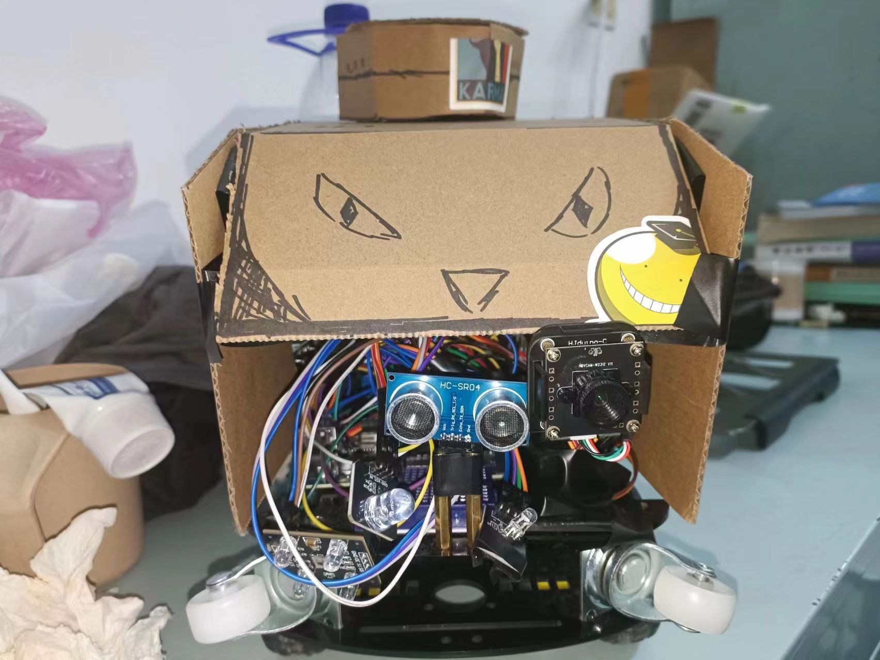
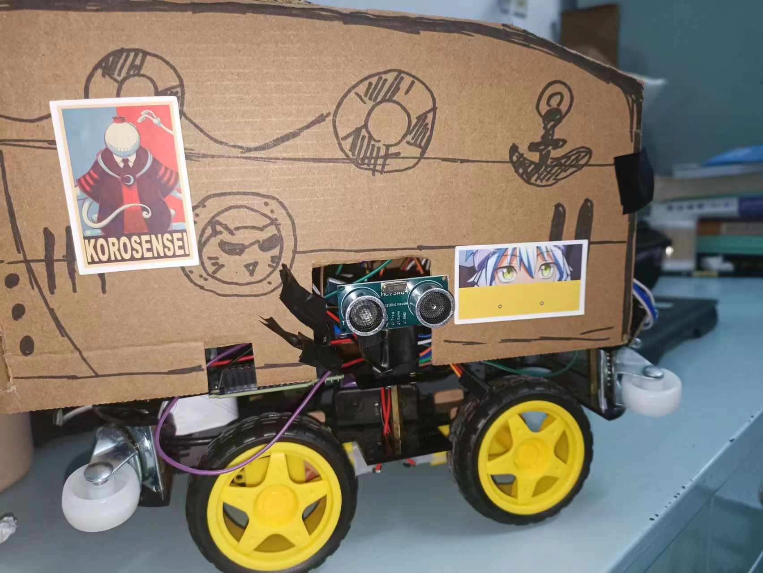
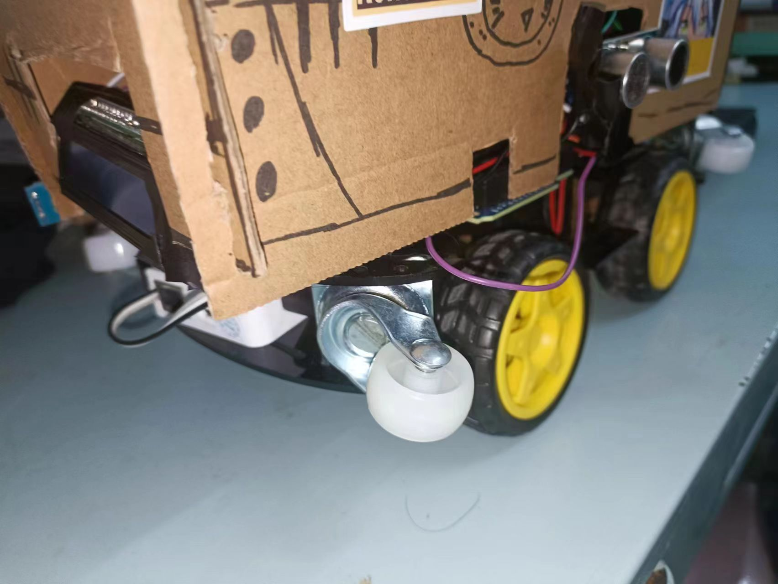
Design Ideas（apperance of car）
设计思路

Slide 9
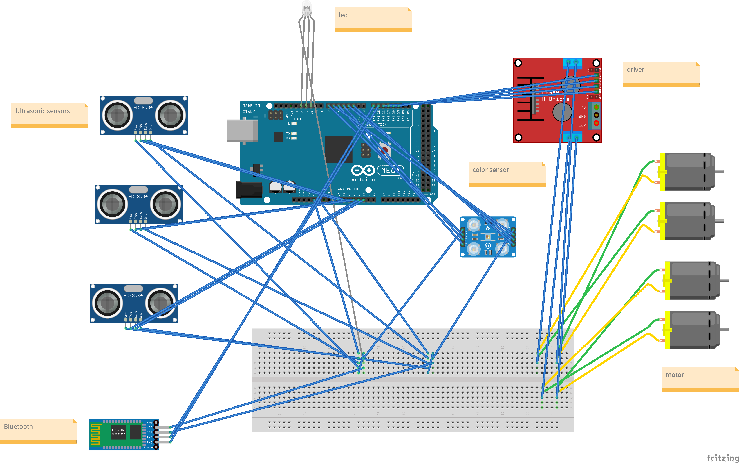
Design Ideas（circuits of car）
设计思路

Slide 10
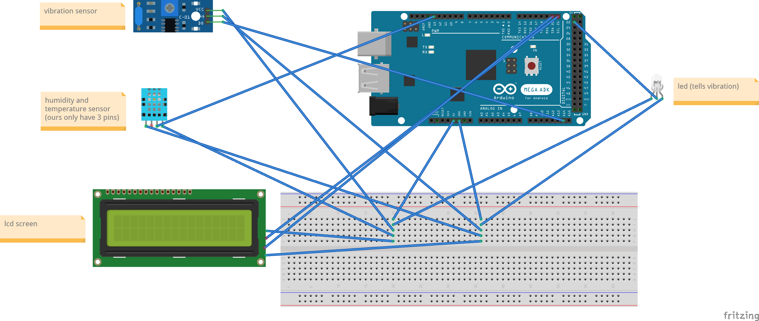
Design Ideas（circuits of car）
设计思路

Slide 11
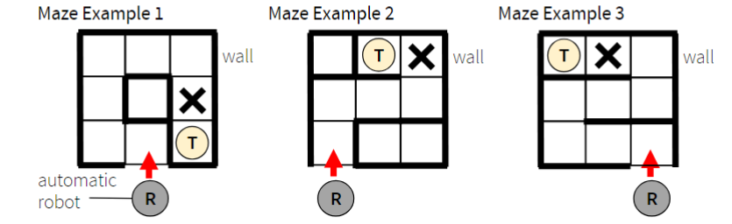
Design Ideas（running logic of car）
设计思路
Maze Exploration Logic
1.Initialization: At the start, the car initializes its sensors, control system, and operational parameters.
2.Commence Exploration: The car begins to move along a certain path within the maze.
3.Timed Distance Measurement: At specified intervals, the car uses distance sensors to measure obstacles' distances in front, to the right, and to the left.
4.Continuous Exploration: The car continues to move forward based on the selected actions until it reaches the exit or encounters an impassable situation.
5.Termination of Exploration: When the car successfully exits the maze, it decides to stop running and return exploration results based on specific logical conditions.
6. Return of Exploration Results: Once the exploration concludes, the car can provide the maze map

Slide 12
Design Ideas（running logic of car）
设计思路
Maze Exploration Logic
Action Selection: Based on the measured distances, the car chooses actions in order of priority:
If the right side is clear, it turns right.
If the right side is blocked but the front is clear, it moves forward.
If both the right side and front are blocked but the left side is clear, it turns left.
If all three directions are blocked, indicating a dead end, the car performs a U-turn.

Slide 13
Design Ideas（running logic of car）
设计思路
Stopping Logic
Using a logic function for intersection detection, each time distance is checked, it determines whether the current location is an intersection. If it is an intersection, a record is incremented.
Whenever it's determined that the location is not an intersection, the recorded data is reset to zero.
When the recorded data reaches three, the car will stop.

Slide 14
Design Ideas（running logic of car）
设计思路
Stopping Logic
void forkDectect(int rightDistance,int frontDistance,int leftDistance)
{
if ((rightDistance > 35 && rightDistance < 400!=0)+(frontDistance > obstacleDistance && frontDistance < 400!=0)+(leftDistance > 35 && leftDistance < 400!=0)>=2)
{
state++;
}
}
void loop() {
if(state==2)
{
for (int i = 0; i < 10; i++) {
for (int j = 0; j < 10; j++) {
Serial.print(maze[i][j]);blueTooth.println(maze[i][j]);
Serial.print("\t");
}
Serial.println();
state=3;
}
else if(state==3)
.............}

Slide 15
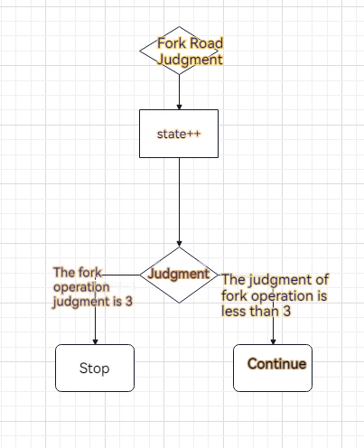
Design Ideas（running logic of car）
设计思路
Stopping Logic

Slide 16
Design Ideas（running logic of car）
设计思路
Maze Mapping Logic
During the initialization process, a 10x10 array is created for the maze, and all its data is set to zero.
The car has attributes for four directions: east, south, west, and north.
Each time the car moves forward, it updates the map based on its current direction.
Each time the car changes direction, it updates its direction attribute according to the current direction and the new changing.
When the car finishes its operation, it returns the map data.

Slide 17
Design Ideas（running logic of car）
设计思路
Maze Mapping Logic
// Turn left
recordMove(TURNLEFT);
currentDirection = (currentDirection + 3) % 4; // Updating the direction of the trolley
// Initialise the maze map array
for (int i = 0; i < mazeSizeX; i++) {
for (int j = 0; j < mazeSizeY; j++) {
maze[i][j] = 0; // 0 for unexplored locations
}
}
// Forward
recordMove(FORWARD);
updatePosition(currentDirection);

Slide 18
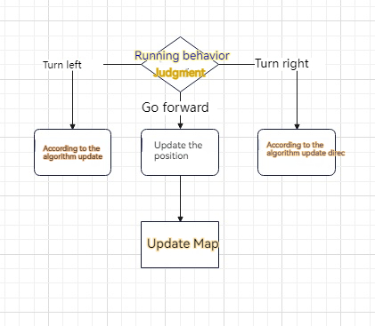
Design Ideas（running logic of car）
设计思路
Maze Mapping Logic

Slide 19
Design Ideas（running logic of car）
设计思路
Treasure Hunting Logic
Utilizing the car's color recognition module, it performs a color recognition process each time it runs.
When a change in color is detected, the car will come to a prolonged stop to take a photograph.

Slide 20
Design Ideas（hardware design of car）
设计思路
Other Functions
In order to reduce the workload on the development board, we have chosen to use two development boards on a single car.
The main functions related to map exploration and treasure recognition are integrated on the same development board.
Additional functions such as temperature and humidity sensing are integrated on the same development board.
Ensuring that the two development boards do not have any functional interference or logical connection is essential.

Slide 21
Design Ideas（website）
设计思路
The basic functions are as follows:
1.Implement user registration and login.
2.Implement the display and editing of treasure hunting information.
3.Implement the uploading of car running information.
4.Displaying information about the company

Slide 22
Design Ideas（treasure Identification）
设计思路
A demonstration of an object recognition program based on computer vision: Combining image GUI display with the YOLO model to achieve intelligent recognition of books, keys, and Rubik's cubes.
1.Introduction to YOLO Model: YOLO (You Only Look Once) is a real-time object detection algorithm that can recognize and locate objects in an image with a single forward pass. Compared to other object detection algorithms, YOLO is known for its speed and high accuracy, making it suitable for real-time applications.
2.Image GUI Display: To facilitate real-time viewing of recognition results by users, we will use image GUI display techniques. Users can interact with the GUI by clicking or dragging to select areas of interest. The program will then automatically perform object recognition within the selected region and draw bounding boxes around the recognized objects on the image. Additionally, we will display relevant information on the GUI interface, such as recognition accuracy and confidence scores, to help users better understand the recognition results.
3.Integration of YOLO Model and Image GUI Display: In this project, we will combine the YOLO model with image GUI display techniques to achieve intelligent recognition of books, keys, and Rubik's cubes. First, we'll utilize the YOLO model to perform object recognition on the input image. Next, based on the recognition results, we'll draw bounding boxes on the image using the GUI. Finally, we'll display the recognition results through the GUI interface, providing users with an intuitive and interactive experience.

Slide 23
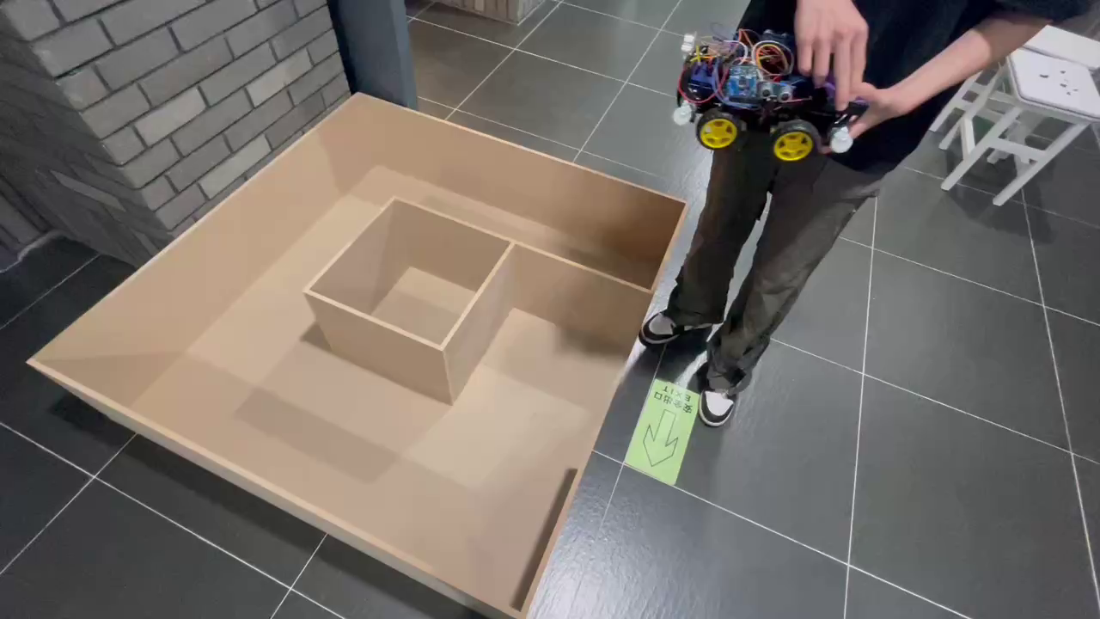
Function Show
功能展示
maze detection
Implementation:
Successfully navigate the entire maze and return.

Slide 24
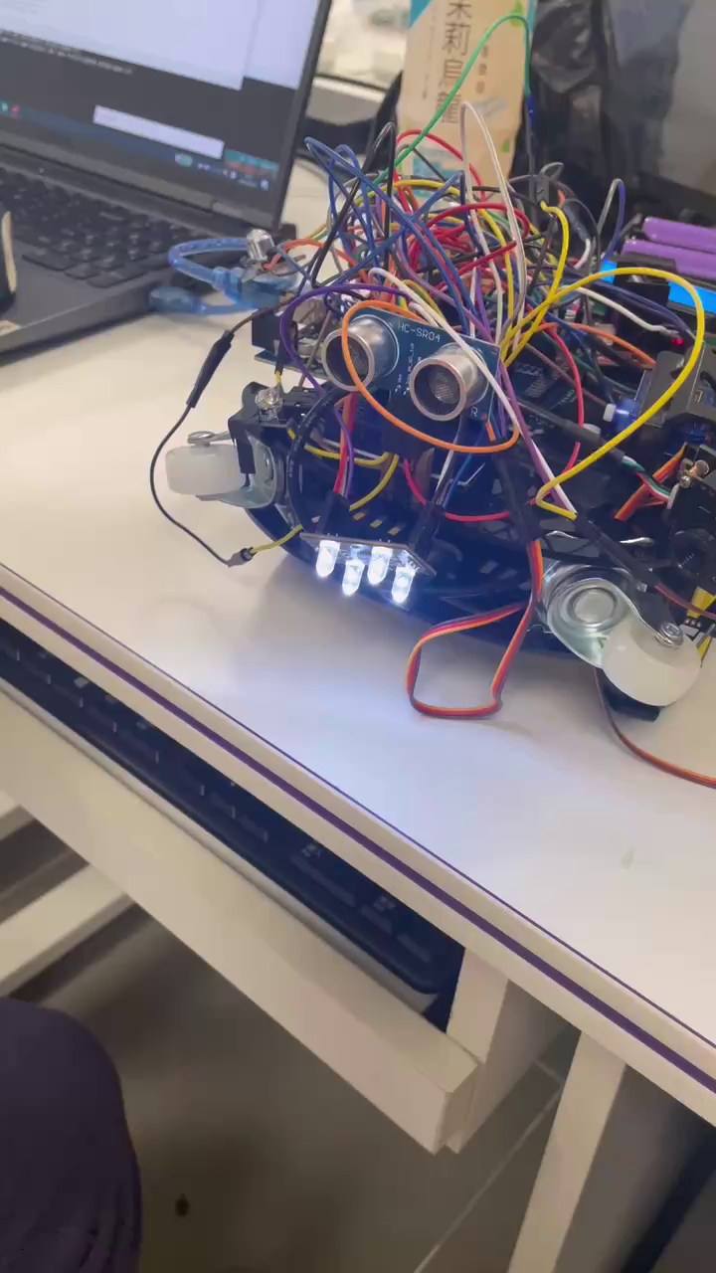
Function Show
功能展示
Treasure Recognition
Implementation:
Detect if a treasure exists ahead and identify its color.

Slide 25
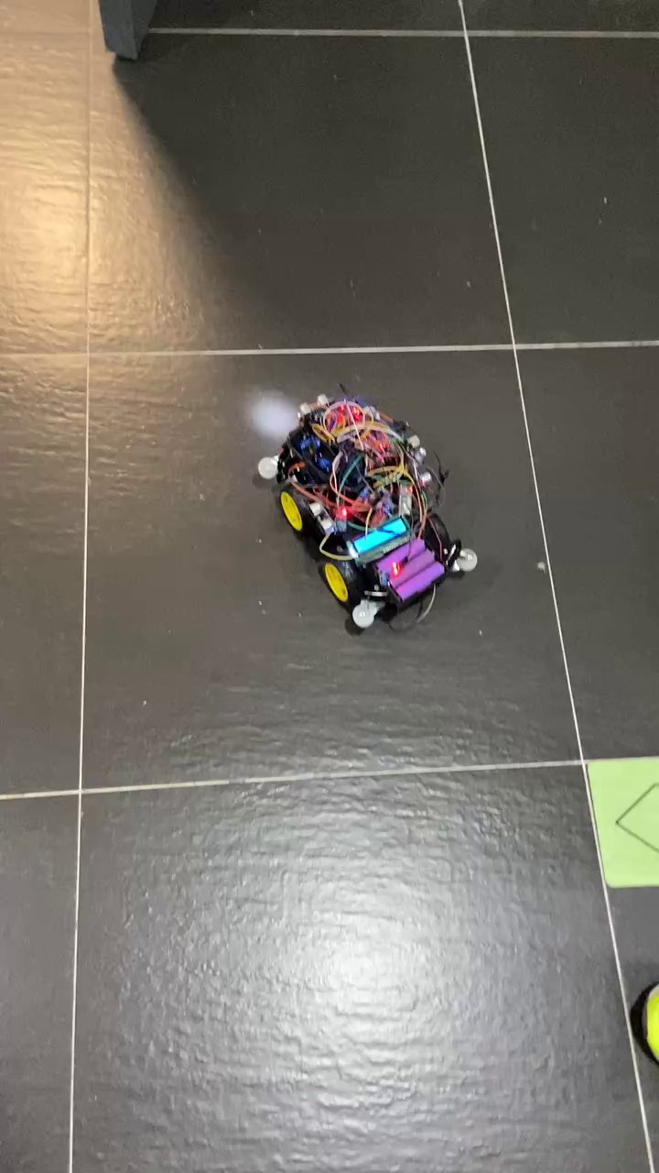
Function Show
功能展示
Storage and transmission of data
Implementation:
Utilize Bluetooth and WiFi for transmitting maze data and car motion data to other devices. Employ a specific algorithm to store the detailed data in the development board, and provide an option during each startup to choose whether to clear the maze data.

Slide 26


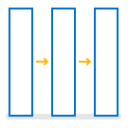

Function Show
功能展示
Additional function
Temperature and
humidity detection and
Runtime Detection and
display
Hazard warning
and avoidance
Mode selection
and contro
Remote Control
& Photo
Timed update of the maze temperature and humidity data change and runtime on the LCD board
When an unexpected vibration occurs use the LED light to alarm and emergency back, use the beeping sensor for the rest of the prompts.
。
Use LED lights to show the corresponding state of the car, there are three kinds of states: explore, backward, and end.
Remote data transmission and control using infrared components, WiFi components, Bluetooth components

Slide 27
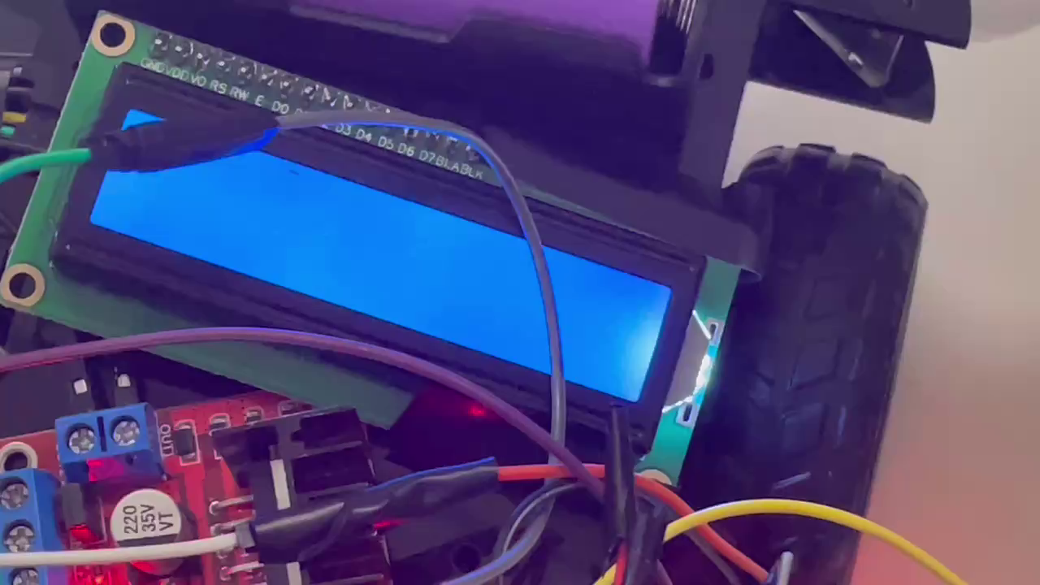
Function Show
功能展示
Temperature and humidity detection with runtime detection and display
Implementation:
Utilize a temperature and humidity sensor for temperature and humidity detection. Employ a specific algorithm and an LCD display module to show the corresponding temperature, humidity, and runtime information.

Slide 28
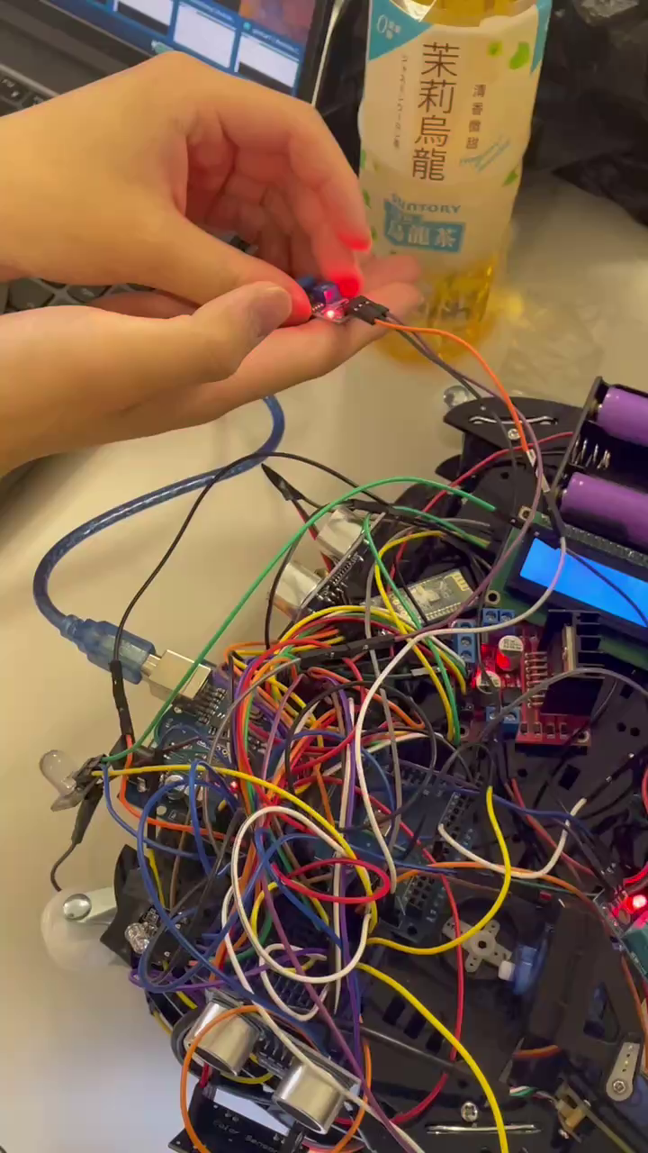
Function Show
功能展示
Hazard warning and avoidance
Implementation:
Utilize a vibration sensor to transmit relevant data.
Implement a specific algorithm to trigger an alarm when
the vibration exceeds a certain threshold.

Slide 29
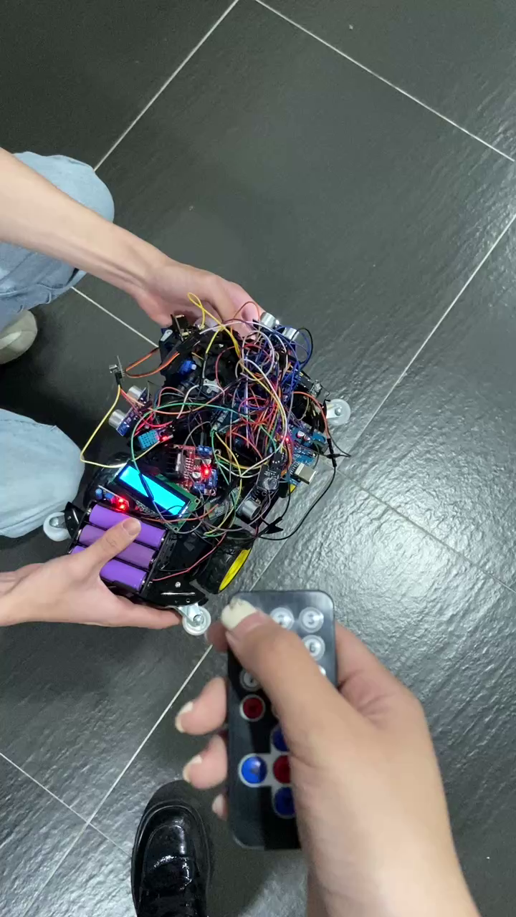
Function Show
功能展示
Mode selection and control
Implementation:
Allow the car to choose between different modes of operation each time it starts, including manual control, maze exploration for treasure, and data transmission. Employ a specific algorithm to assign different behavioral logic to the car for each state and use LED lights to indicate its current mode

Slide 30
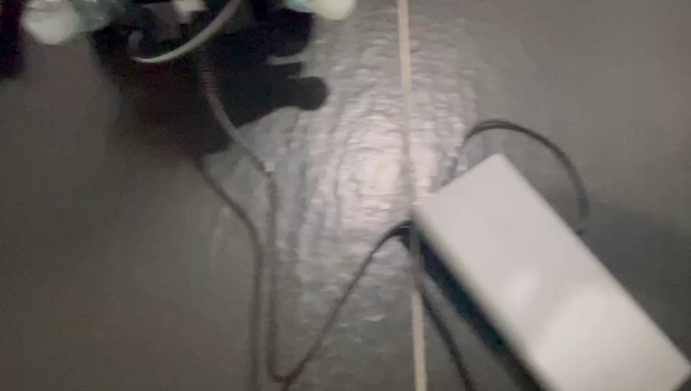
Function Show
功能展示
Remote Control & Photo
Implementation:
Utilize infrared components, WiFi modules, and Bluetooth components for remote data transmission and control. Enable remote control of the car's movement using an infrared remote control. Control the camera angle via Bluetooth and capture photos. Use the WiFi module for capturing photos and transmitting them

Slide 31
Function Show
功能展示
Treasure Identification
Combining the YOLO model with image GUI display techniques to achieve intelligent recognition of books, keys, and Rubik's cubes. First, the YOLO model is used to perform object recognition on the input image. Then, based on the recognition results, bounding boxes are drawn on the image using the GUI. Finally, the recognition results are displayed through the GUI interface, providing users with an intuitive operating experience.

Slide 32
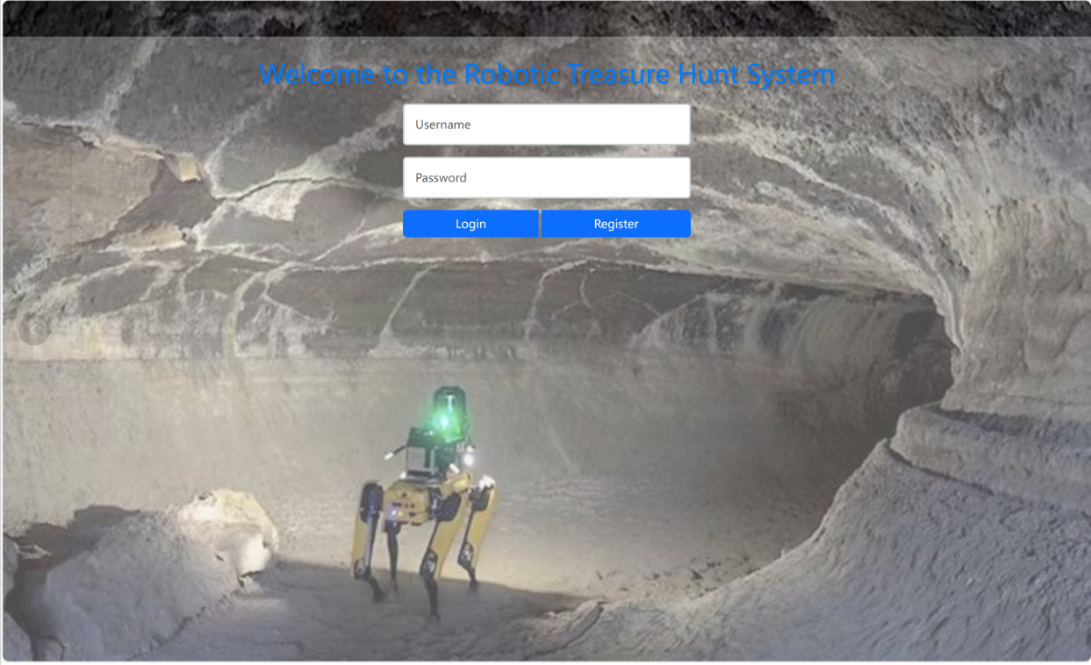
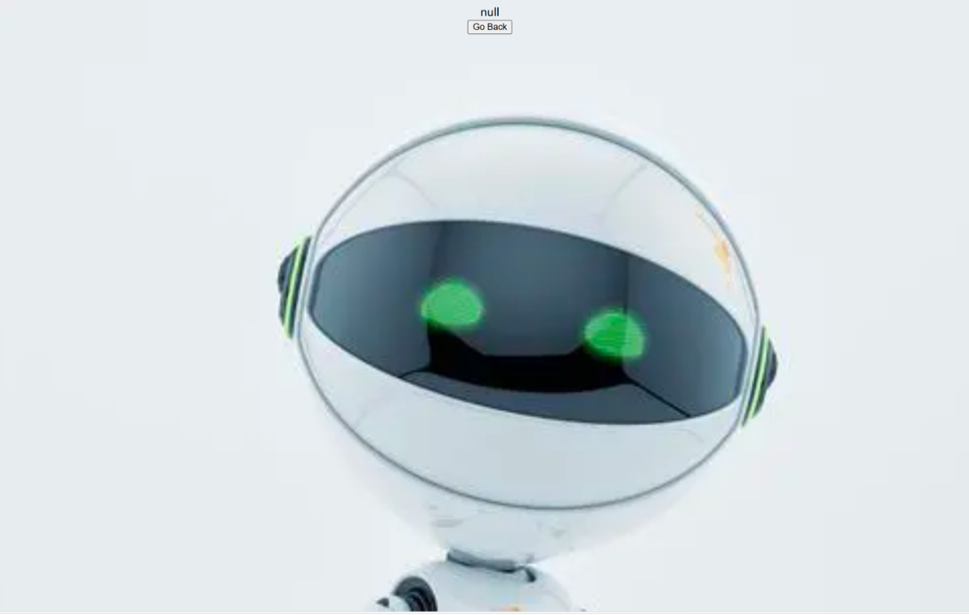
Function Show
功能展示
User Login and Registration
This displays the login screen, where the user can login or register a new account. If the account does not exist or the wrong password has been entered, the user will be redirected to the "null" screen.

Slide 33
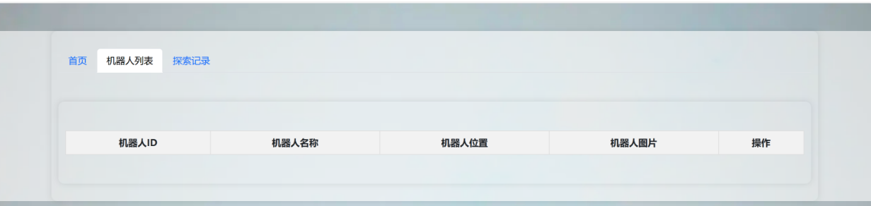
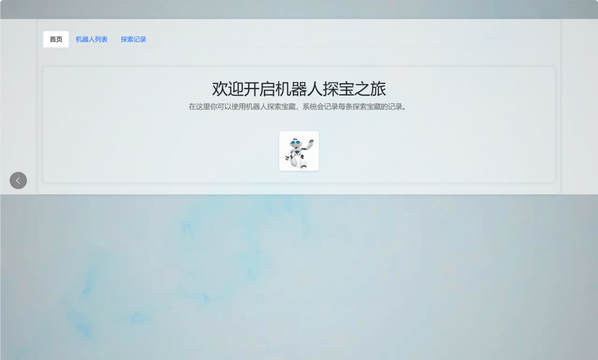
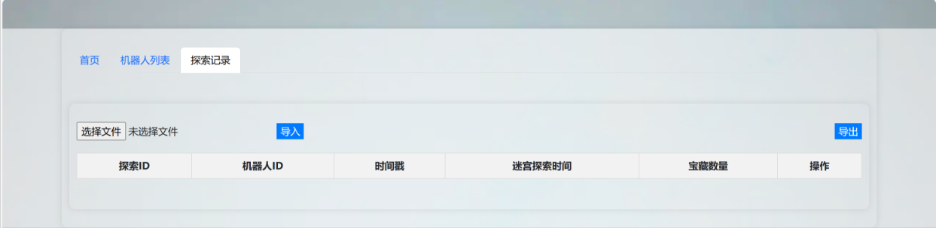
Function Show
功能展示
Explore the Record Showcase
Here is the robot data page and the editing page. The robot list allows you to view all the information about the robot, and the exploration list allows you to see the robot's exploration records. The editing page allows you to make changes to both the robot's basic data and its exploration data.

Slide 34
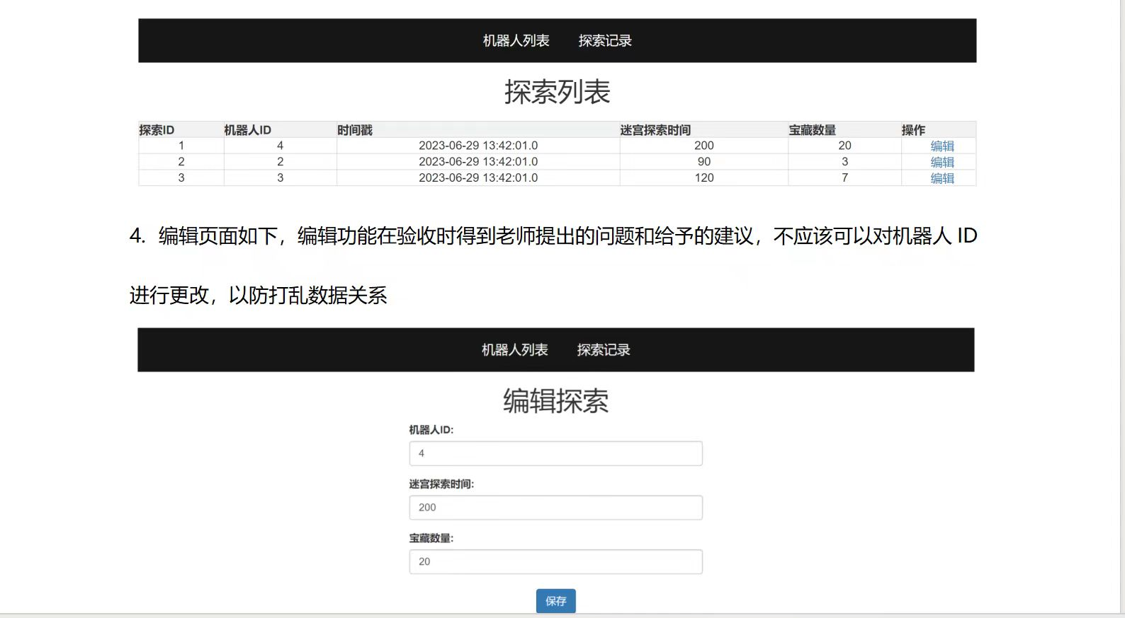
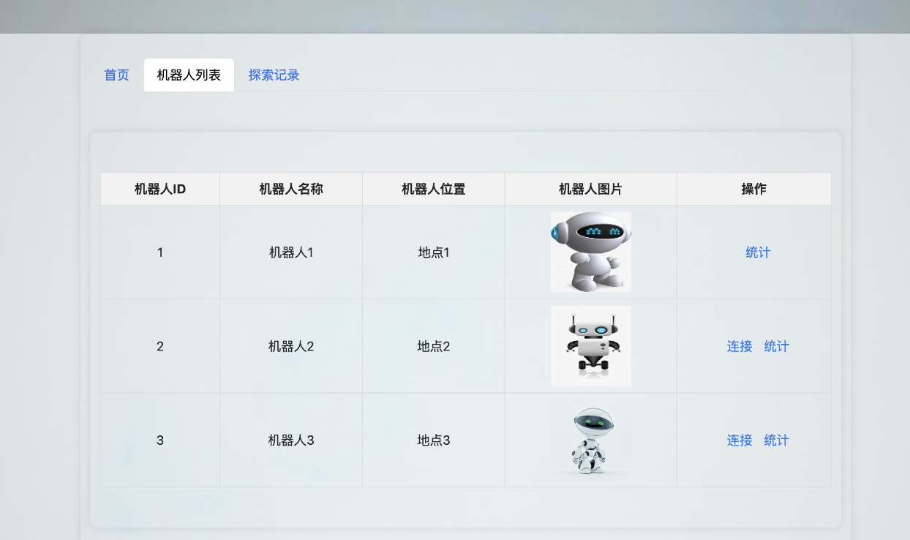
Function Show
功能展示
Explore record editing
Here is the robot data page and the editing page. The robot list allows you to view all the information about the robot, and the exploration list allows you to see the robot's exploration records. The editing page allows you to make changes to both the robot's basic data and its exploration data.

Slide 35
Summary & Experience
总结与经验
Through this design and production process, we have come to appreciate the importance of both practical skills and theoretical knowledge. The integration of theory and practice is paramount. Of course, we also recognize our shortcomings. Due to our lack of theoretical knowledge and less-than-ideal practical skills, we encountered numerous obstacles during the work, often taking the wrong path. Although we inevitably faced many challenges during the production process, with the help of our teacher and classmates, we successfully resolved these issues, completed the entire system design, and achieved the final debugging, meeting the expected requirements. We effectively fulfilled the design task.
After multiple revisions and debugging measurements, this design largely adheres to the design requirements. Due to human factors and limitations in software and hardware, the system inevitably introduced some errors. However, through adjustments and precise calculations, we managed to reduce these errors. Throughout the continuous trial and error process, we learned a great deal. Especially with the guidance of our teacher, we gained not only knowledge and results but also, and perhaps more importantly, valuable learning methods and problem-solving skills.

Slide 36
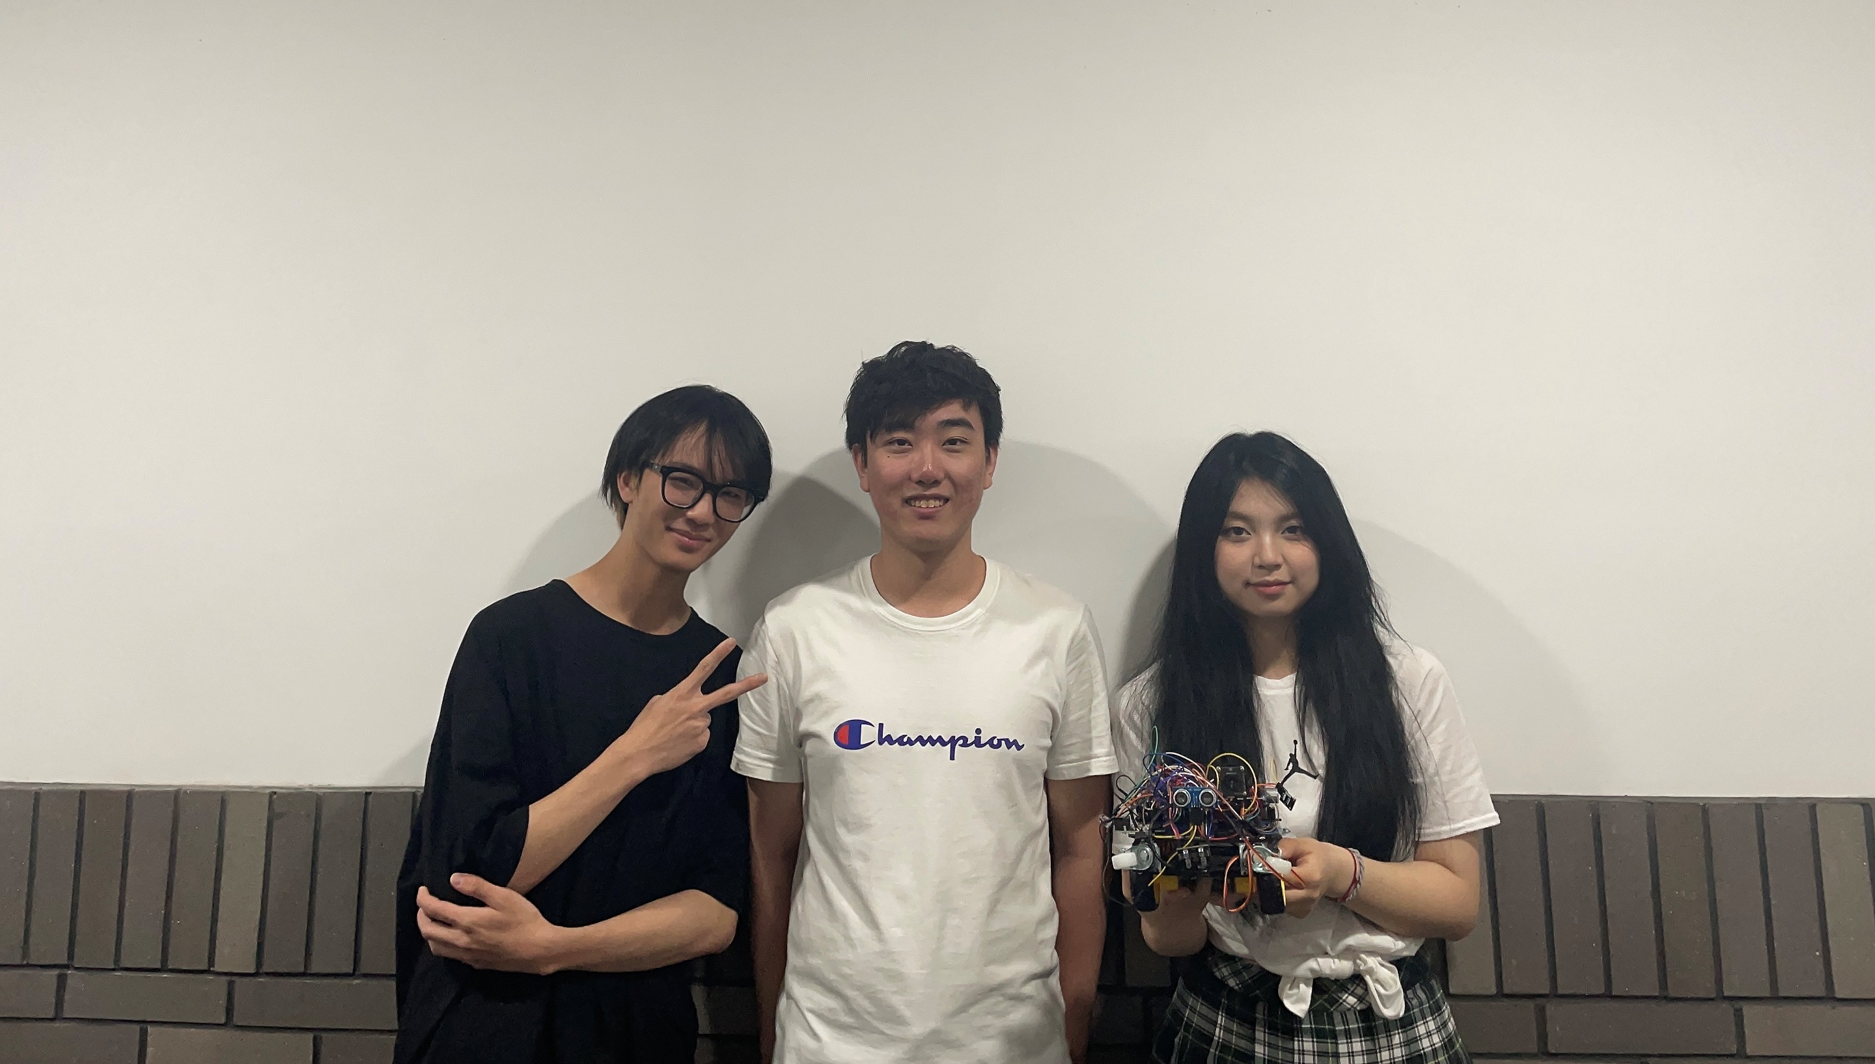
Group Photo~

